Slide 1
ACTEA SPICATA
Dr. C.R. KRISHNA KUMARI AMMA
HOD & PROF
Dept Of Materia Medica

Slide 2
KINGDOM – PLANTAE
UNRANKED – ANGIOSPERMS
UNRANKED – EUDICOTS
ORDER – RANUNCULALES
FAMILY – RANUNCULACEAE
GENUS – ACTEA
SPECIES – A. SPICATA

Slide 3
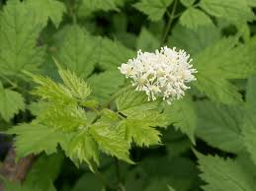

Slide 4
Actaea spicata (Baneberry, Eurasian Baneberry, or Herb Christopher) is a species of flowering plant in the genus Actaea, native to Europe and Western Asia.
It is a herbaceous perennial plant growing 30-60 cm tall. It has toothed, bipinnate compound leaves up to 40 cm long and 30 cm broad.
The flowers are white, with 4-6 petaloid sepals, and are produced in an erect raceme about 10 cm long.
Thefruit is an oval glossy black berry, 10-11 mm long and 8 mm diameter.

Slide 5
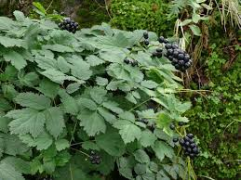

Slide 6
There are two varieties:
Actaea spicata var. spicata. Europe, northwestern Asia; at 0-1900 m altitude.
Actaea spicata var. acuminata (syn. A. acuminata). Southwestern Asia, Himalaya, at 2500-3700 m altitude.

Slide 7
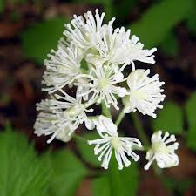

Slide 8
USES
It is an extremely poisonous plant. Despite this, it was used in the past in herbal medicines. It is also grown as an ornamental plant in gardens.
The berries contain cardiogenic toxins which can have an immediate sedative effect on human cardiac muscle tissue, and are the most poisonous part of the plant.
Ingestion of the berries can lead to cardiac arrest and death. The berries are harmless to birds, the plants' primary seed dispersers.

Slide 9
HOMOEOPATHICALLY
Actea Spicata can be a acceptable fix for synovial rheumatism, and especially rheumatism from the smaller knees and lower back. Rheumatic pain around tiny joints, including hand, fingers, ankles, feet.
Actea Spicata includes a special affinity for a rheumatism of your wrist articulation. Your bones starts off aching as there are inflammation out of small weakness. There may be overwhelming discomfort. Bones usually are sore to touch having weakness and pins and needles. Arm can be swollen and red Aches tend to be on the violent carrying, drawing personality. Actea Spicata also helps in Writers cramping. There's also bringing ache with loins.

Slide 10
OTHER SYMPTOMS…..
Ears painful to the touch, severe pain in ears when blowing or sneezing the nose are the symptoms of Actaea spicata for ears.
Eyes we see the symptoms are - Catarrhal ophthalmia, sugillations of the conjunctiva, spots before eyes when looking gradually, objects seem blue colored.
Submaxillary glands, glands painful when chewing, pains in throat when breathing cold morning, tearing pains in throat, throat becomes aching when talking are the symptoms of Actaea spicata for throat.

